Slide 1
Lecture 2 - Review of Basic Vector/Matrix Notations and Operations
DS 4400: Machine Learning and Data Mining 1

Slide 2
Today
Today
Vectors
Matrices
Basic Operations Vector Operations Matrix Operations
Practice Problems

Slide 3
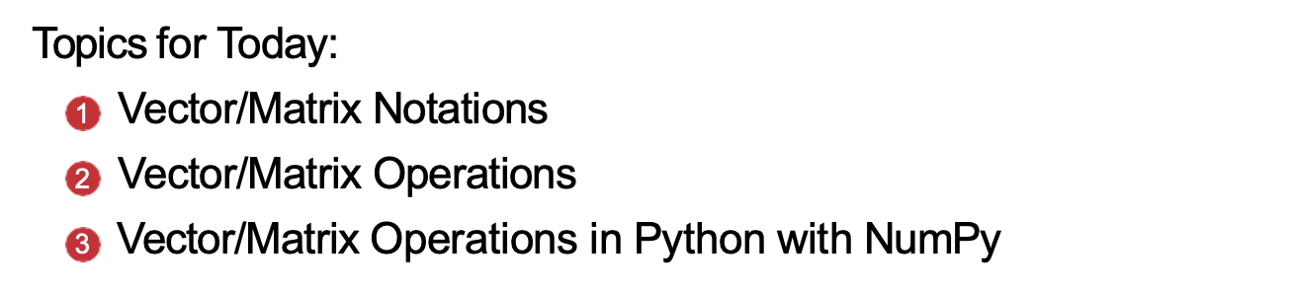
Updates

Slide 4
Example: Recommendation Systems (like Netflix, Amazon)
How Vectors and Matrix Multiplication Drive Recommendations

Slide 5
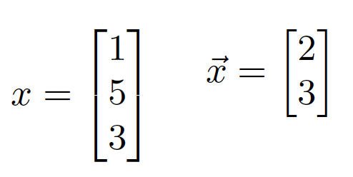
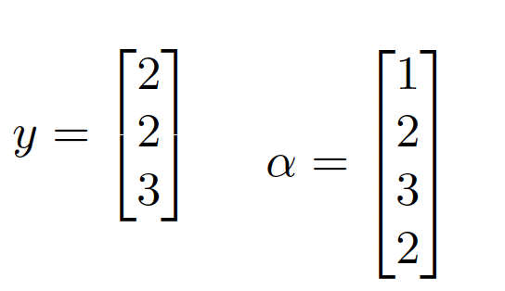
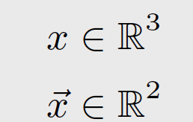
What is a vector?
A vector is a column of numbers enclosed in a bracket.
Examples: Examples:
Dimension/Space
We denote the dimension, and the space of the vector with:
Notation:
You can denote
Notation:
A vector
vectors in several ways. We will mostly use lower case cursive notation, but occasionally add a arrow above, or use bold font.
doesn’t need to be the Latin letter x; it can be any lowercase letter, Latin or even Greek.
The notation x ∈ R³ says that the vector x exists in a 3D vector space of real numbers.

Slide 6
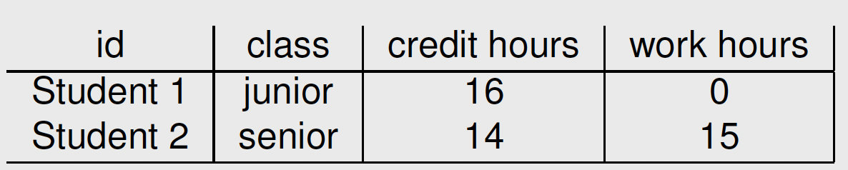
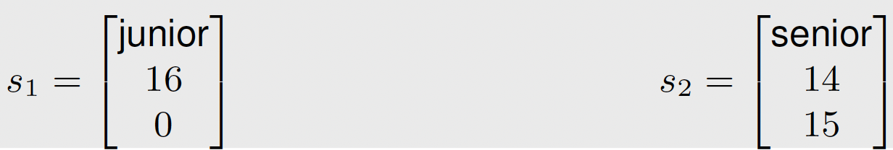
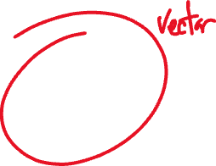


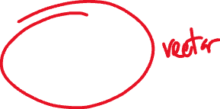


Vectors
In machine learning, a vector represents a sample of data.
Suppose we have a the following sample of data
Each column represents a feature
Each row represents a sample
Mathematically, each sample is represented as a vector:
By default, all vectors are column vectors; this is the common standard in ML and DS.
Some data are numeric and some are categorical. Later we will see that need to represent categorical features numerically

Slide 7
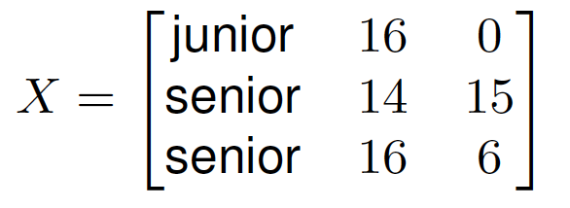
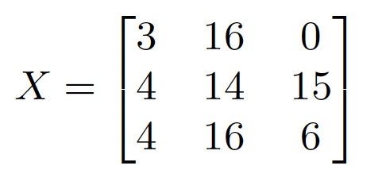

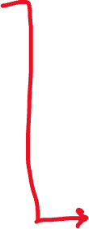



Matrices
A collection of samples becomes a Matrix
The dimension/space of the data matrix is denoted as X ∈ R^{N×d}
N samples and d features
There are multiple ways to repre- sent categorical features as num- bers, i.e. 1 = Freshman, 2 = Sophomore, 3 = Junior, and 4 = Se- nior:
We use capital letters, such as X, to denote the entire dataset as a matrix

Slide 8
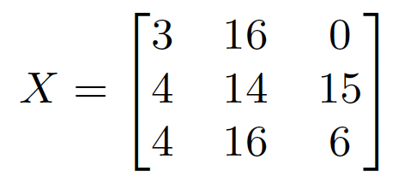
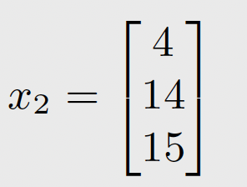
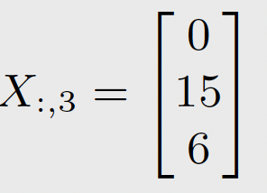




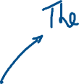
Matrices
Given the matrix:
To refer to a single element in the matrix Xi,j .
To refer to a single column in the matrix X:,j .
To refer to a single row in the matrix Xi,: or xi.
X1,2 = 16
Machine learning we manipulate data that is represented as vectors and matrices.

Slide 9
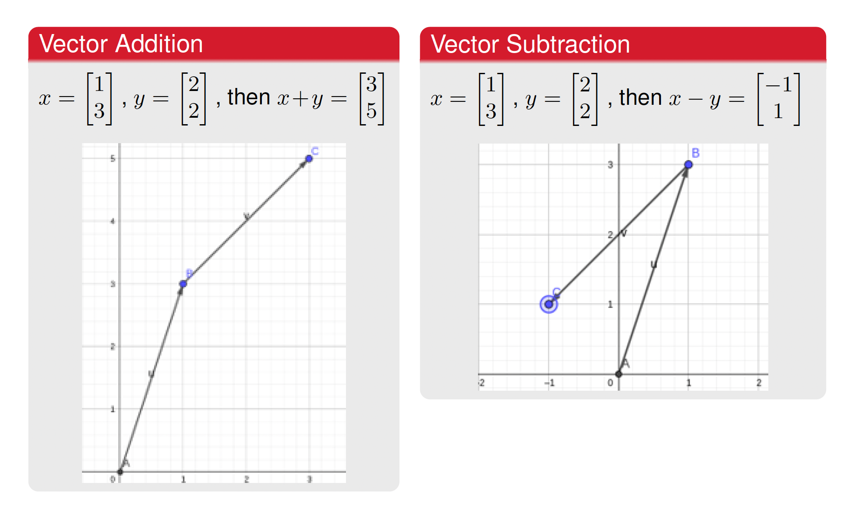
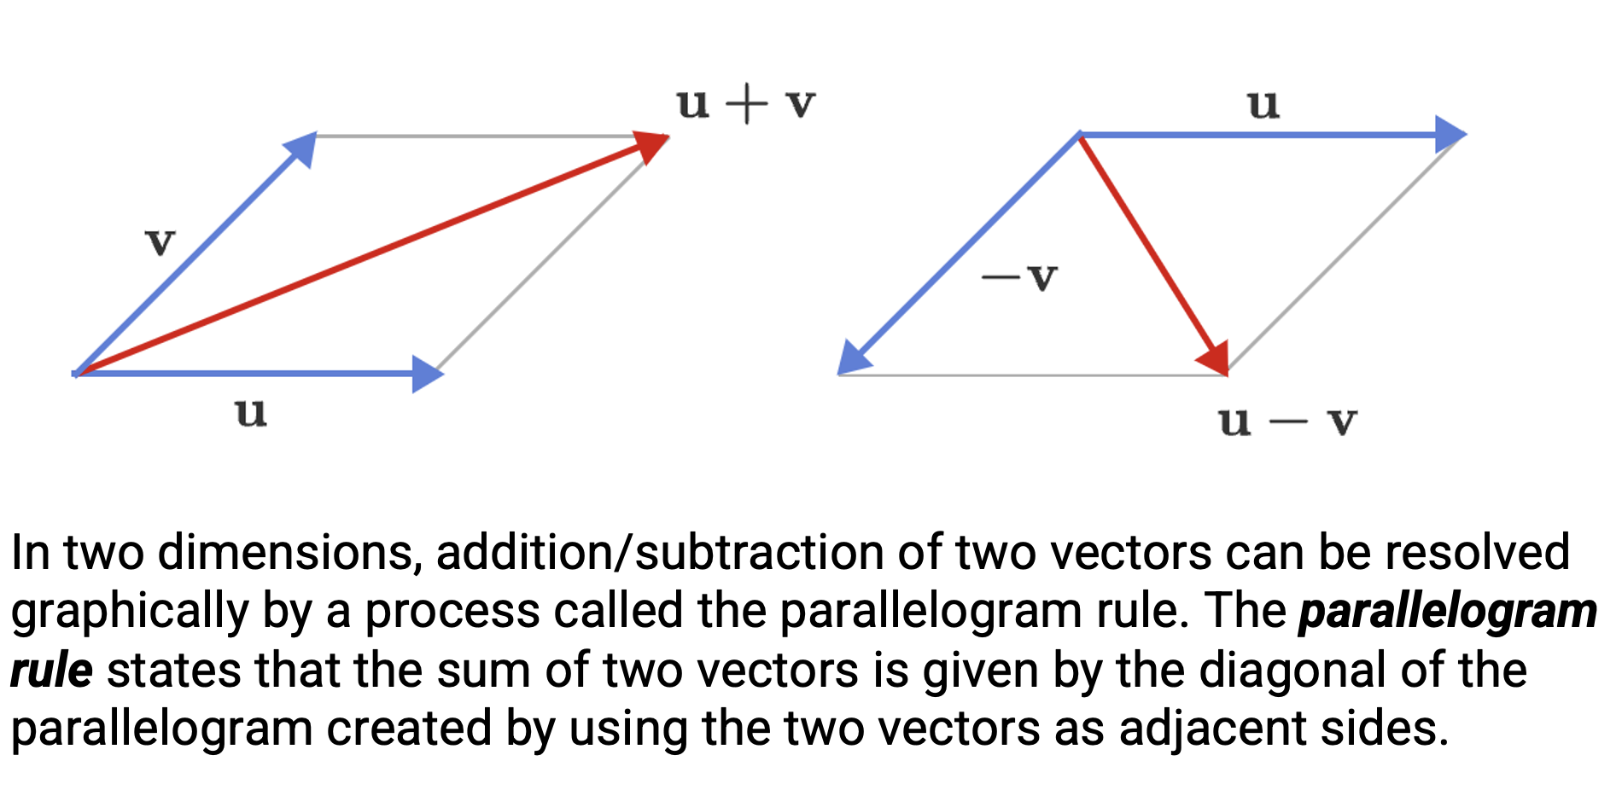
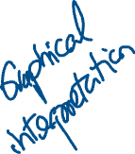


Addition and Subtraction of Vectors

Slide 10
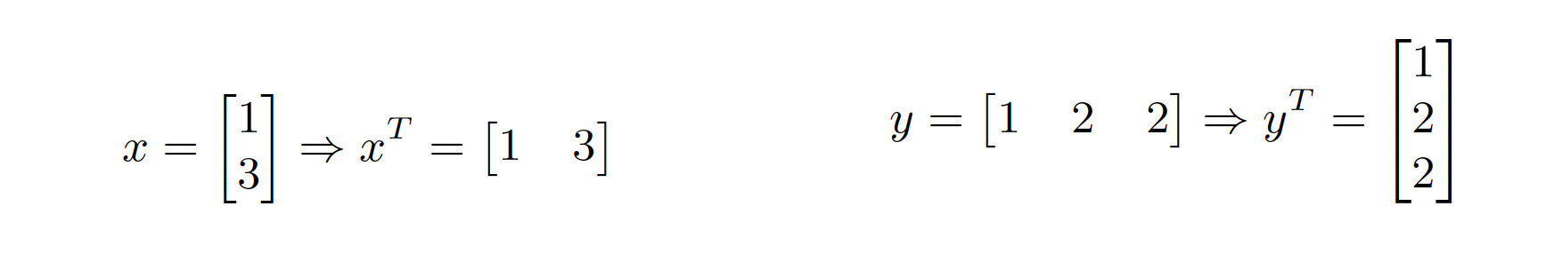
The Transpose Operation
Taking the transpose of a vector consists on flipping a column vector to a row vector (and vice versa).
Examples

Slide 11
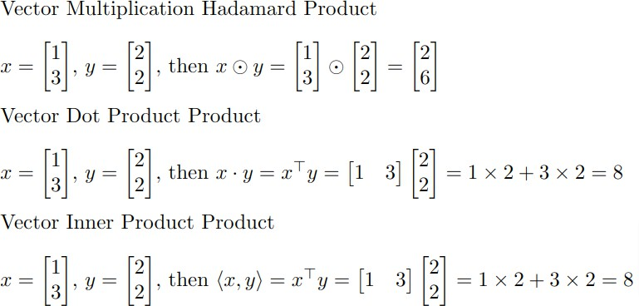
Vector Multiplication (Three Types)
The inner product is a generalization of the dot product that applies to abstract vector spaces, not just Euclidean spaces.

Slide 12
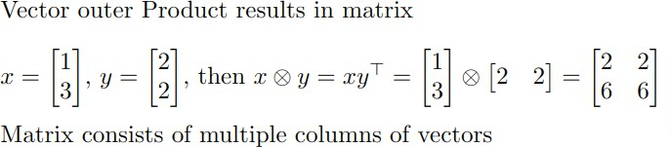
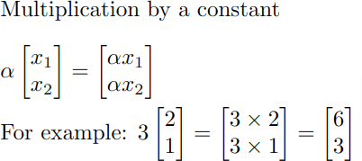



Vector Multiplication (Two More Types)
Take a second to review how to perform these operations in Python in the first part of the numpy examples.ipynb file on Canvas.

Slide 13
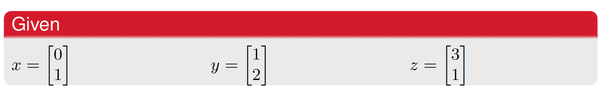
Practice
Practice by solving the following equations
Given
1 x + y + z
2 x − 2y^{T}
3 x ⊗ z
4 z · y
5 y ⊙ x
6 4z^{T} x + (x − y)^{T} (z ⊙ x)

Slide 14






























Slide 15

































Slide 16
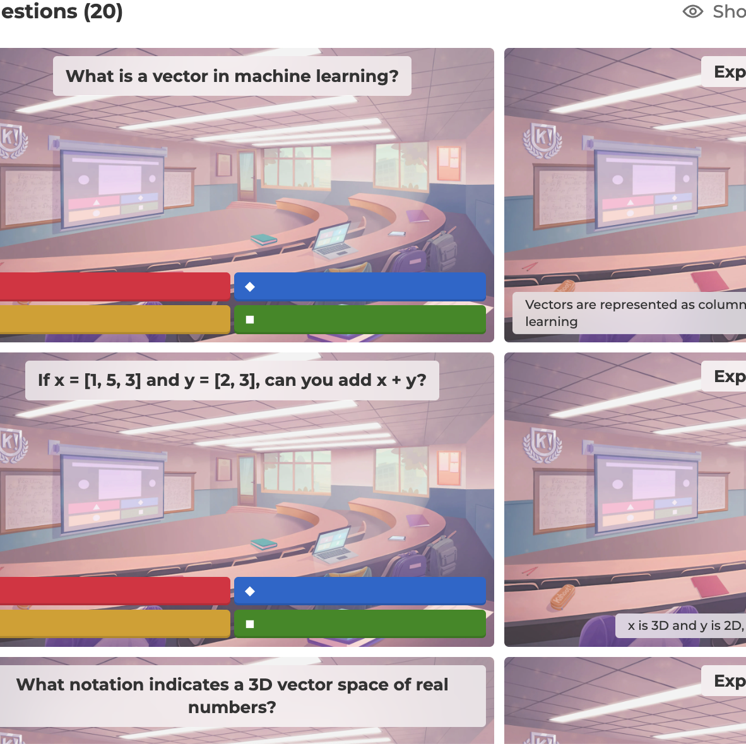
Kahoot Vector operations

Slide 17
Matrix Operations

Slide 18
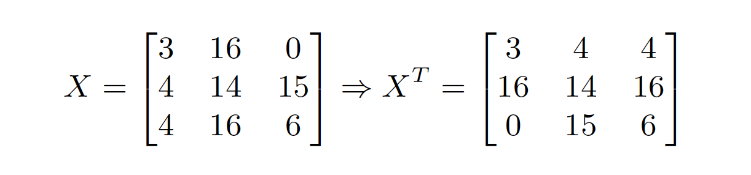
Transposing Matrices
Just like with vectors, we can transpose matrices:
Flip the rows and columns of a matrix to find it’s transpose:

Slide 19
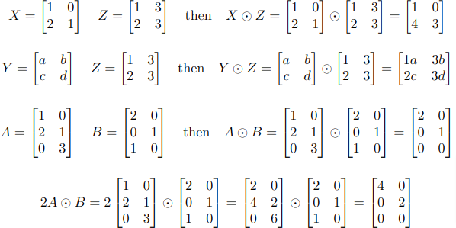




Matrix Hadamard Product
The Hadamard Product is the element-wise product of two matrices; it can only be performed between any two matrices of the same dimension.

Slide 20
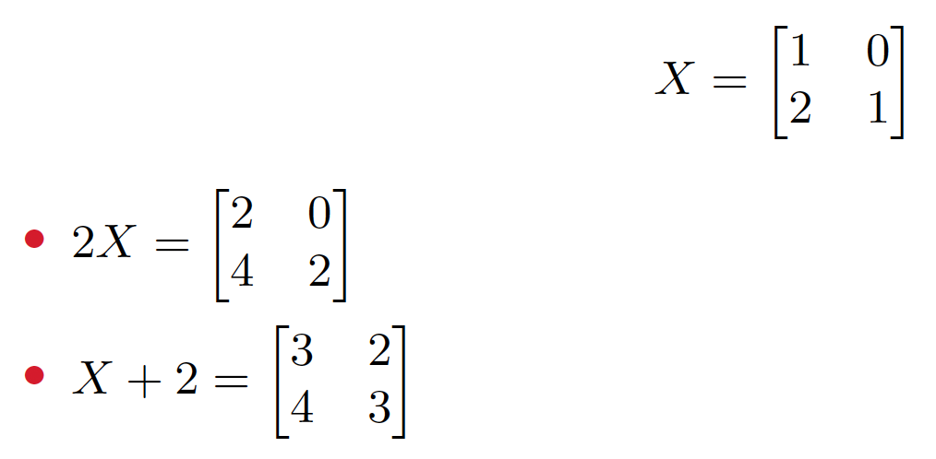
Multiplying and Adding Constants
Matrices can also be multiplied by a constant and have a constant added to them. For example, if:

Slide 21
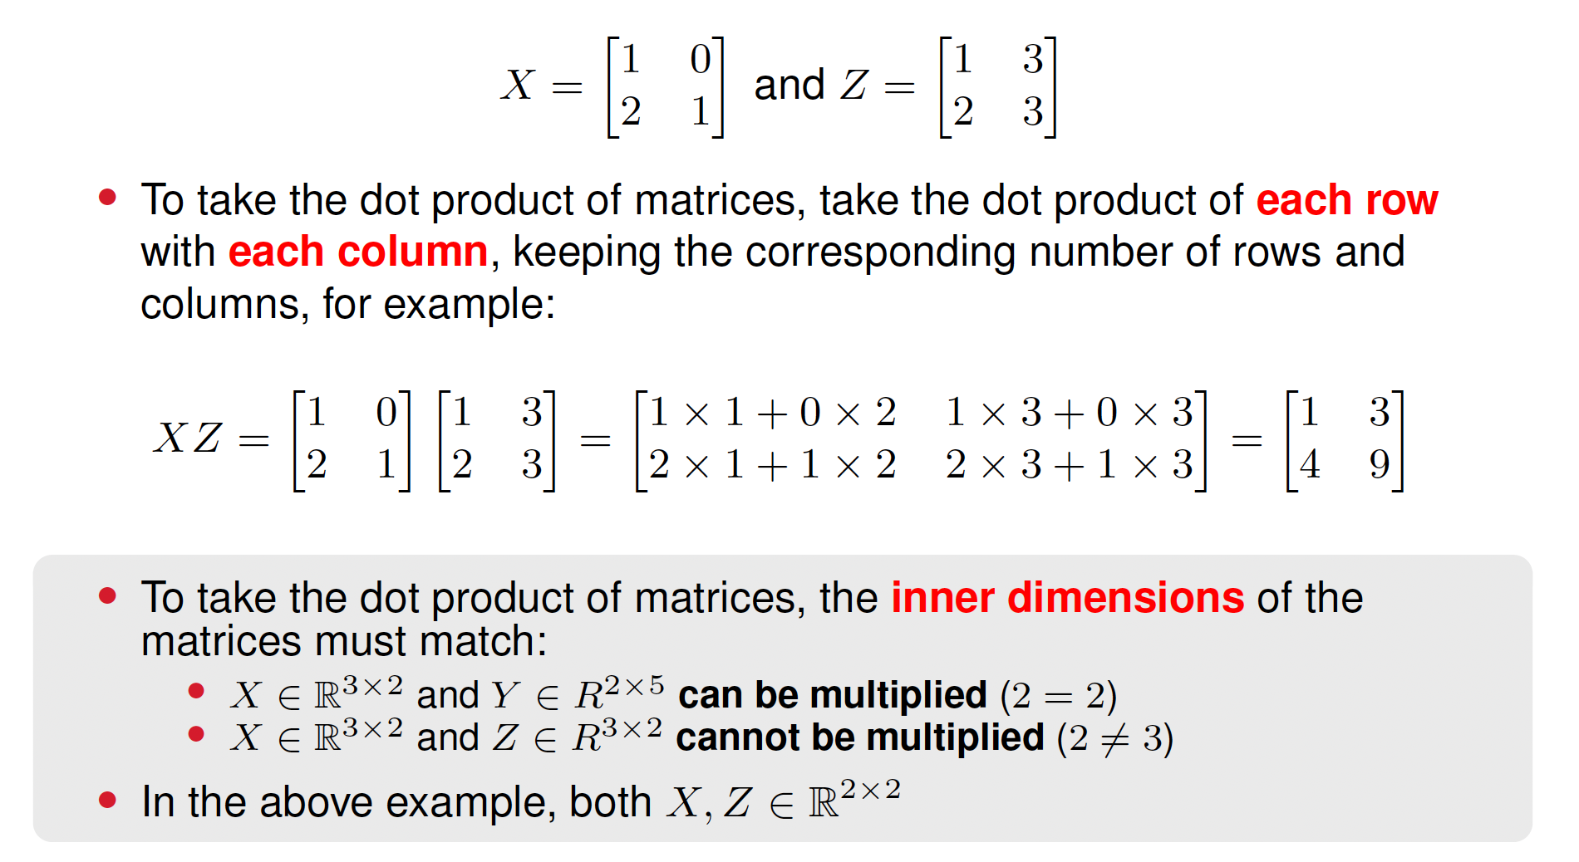

Matrix Dot Product
What we usually consider when we say matrix multiplication.

Slide 22
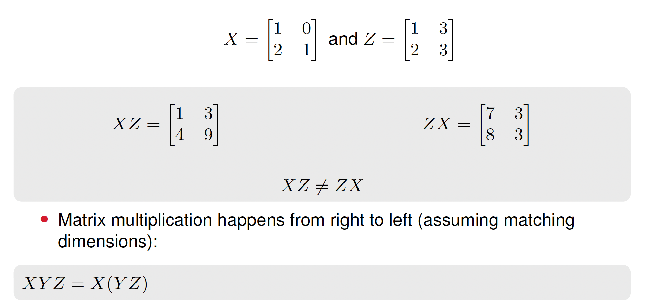
Matrix Multiplication Rules
The transpose of two matrices multiplied together is the product of the transpose of each individual switched in location:
(XY )^{T} = Y ^{T} X^{T}
The order of the multiplication cannot be flipped. For example, if:

Slide 23
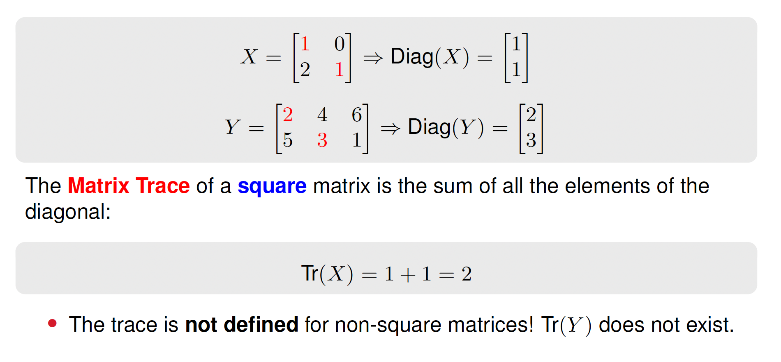
The Diagonal and Trace of a Matrix
The Matrix Diagonal is the vector formed from the diagonal elements of a matrix, beginning with the top left and proceeding down and to the right:

Slide 24
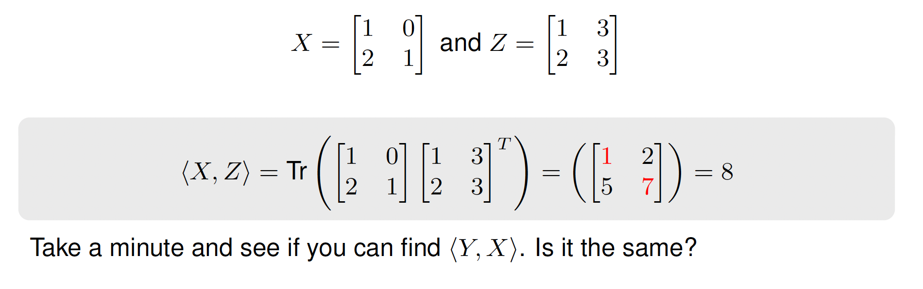


Matrix Inner Product
The matrix inner product is different from the vector inner product. With two matrices, X and Y , their inner product is defined:
⟨X, Y ⟩ = Tr(XY ^{T} )
For example, if:

Slide 25
Brief review
What we have studied so far in this lecture:
For vectors: Hadamard product, dot product, inner product, outer product, multiplication of vector by scalar, addition of vectors
For matrices: matrix Hadamard product, dot product, multiplying a scalar by a matrix, adding matrices, matrix multiplication rules
We learn all of the above, and how to solve it by hand.
What about how to solve it in Python

Slide 26
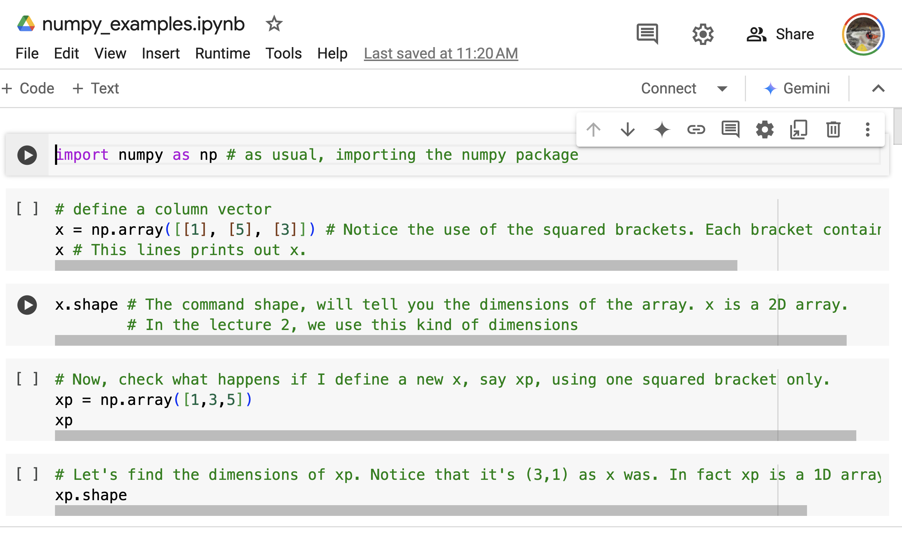
Python code in CANVAS

Slide 27
But, what all this matrix and vector multiplication good for and how it applies in ML?

Slide 28
Application Example of all we learn in this lesson: Recommendation Systems (like Netflix, Amazon)
How Vectors and Matrix Multiplication Drive Recommendations

Slide 29

1. User preferences matrix
Rows represent users.
Columns represent items (e.g., movies, songs, products).
Cells contain user ratings for each movie.
User Action Comedy Drama
U1 5 0 3
U2 0 4 1
U3 3 4 0

Slide 30
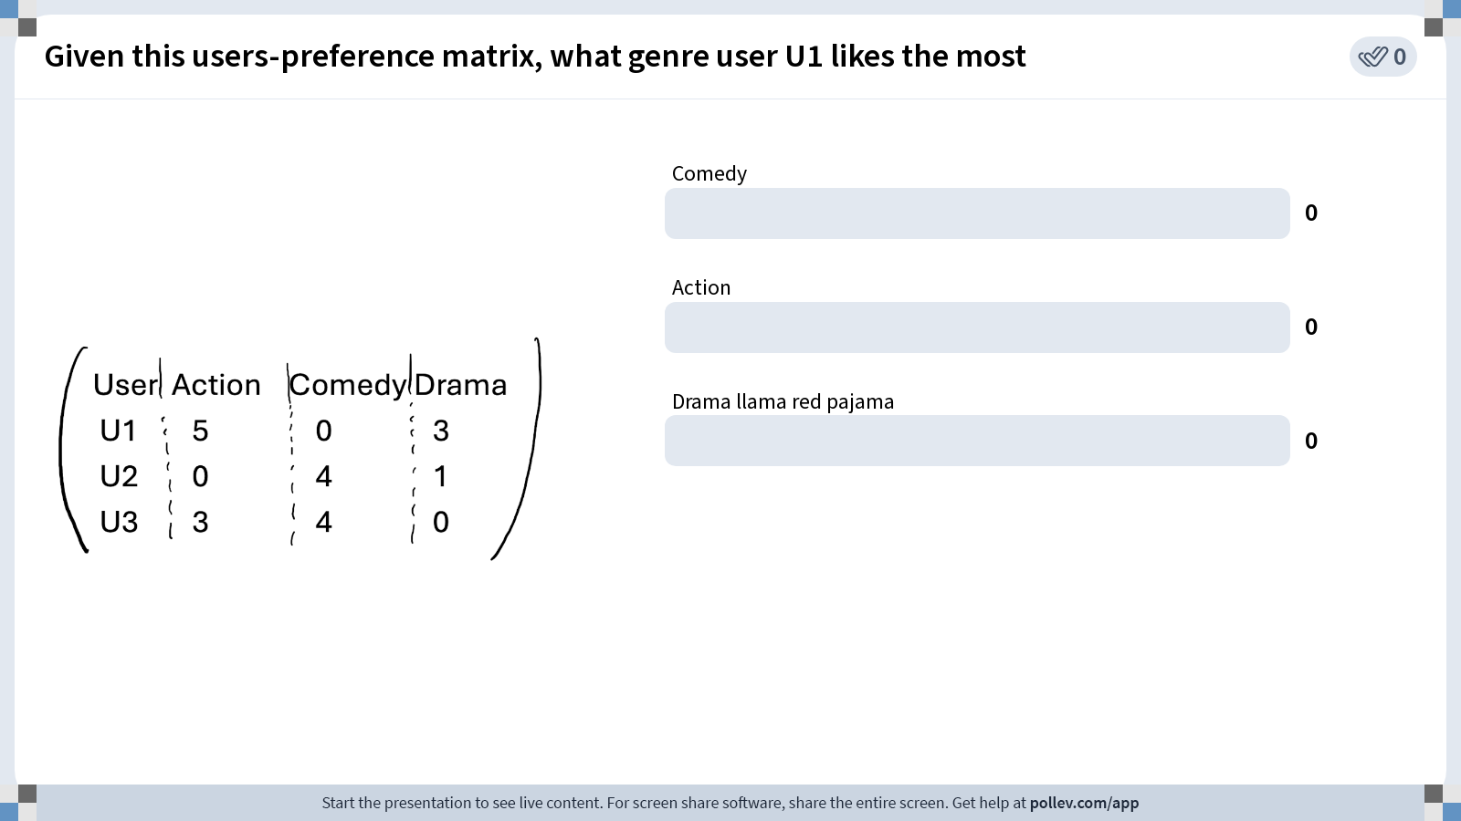
Notes:
Do not modify the notes in this section to avoid tampering with the Poll Everywhere activity. More info at polleverywhere.com/support Given this users-preference matrix, what genre user U1 likes the most
https://www.polleverywhere.com/multiple_choice_polls/FgCUJ4VgNUI5utAQNW4nj?state=opened&flow=Default&onscreen=persist

Slide 31

2. Feature Matrix
Each item (e.g., movie) is described by its features (e.g. genre)
Movie Action Comedy Drama
Movie A 1 0 1
Movie B 0 1 1
Movie C 1 0 0

Slide 32
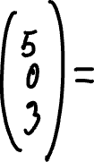









3. Matrix Multiplication for Recommendations
To predict preferences, multiply the user's preferences vector by the feature matrix.
For example, multiply U1 preferences (5 0 3) times the feature matrix. This gives:

Slide 33
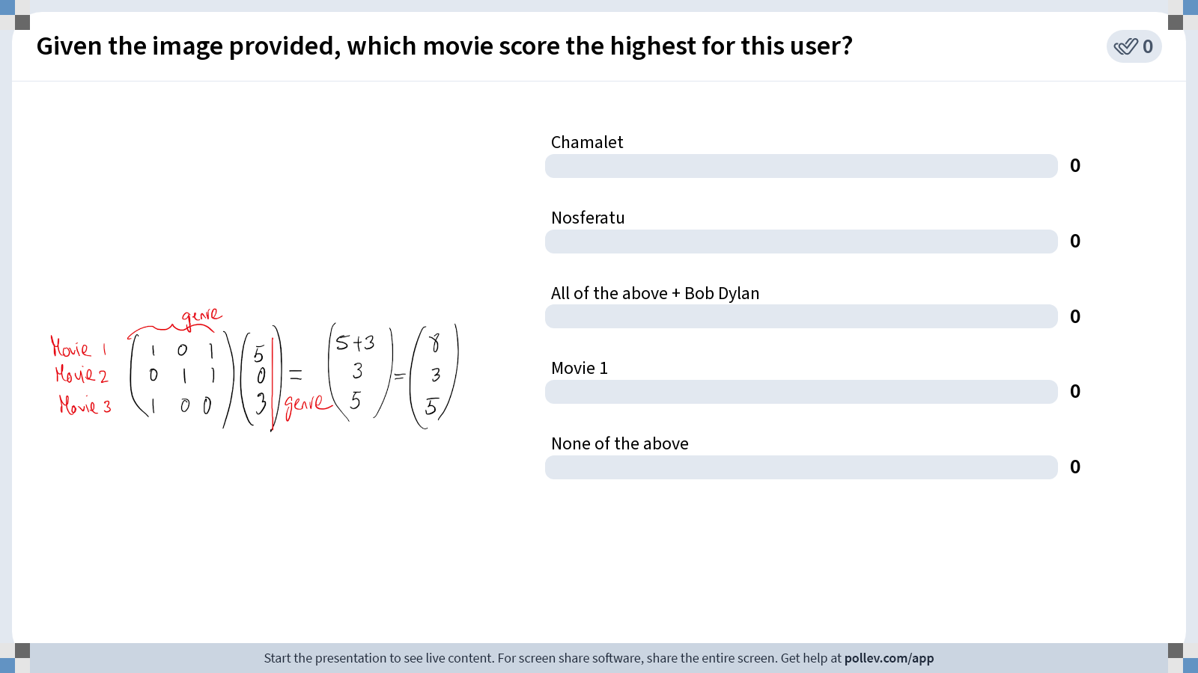
Notes:
Do not modify the notes in this section to avoid tampering with the Poll Everywhere activity. More info at polleverywhere.com/support Given the image provided, which movie score the highest for this user?
https://www.polleverywhere.com/multiple_choice_polls/wx09DNXkbNJ8TWeJtocLN?state=opened&flow=Default&onscreen=persist

Slide 34
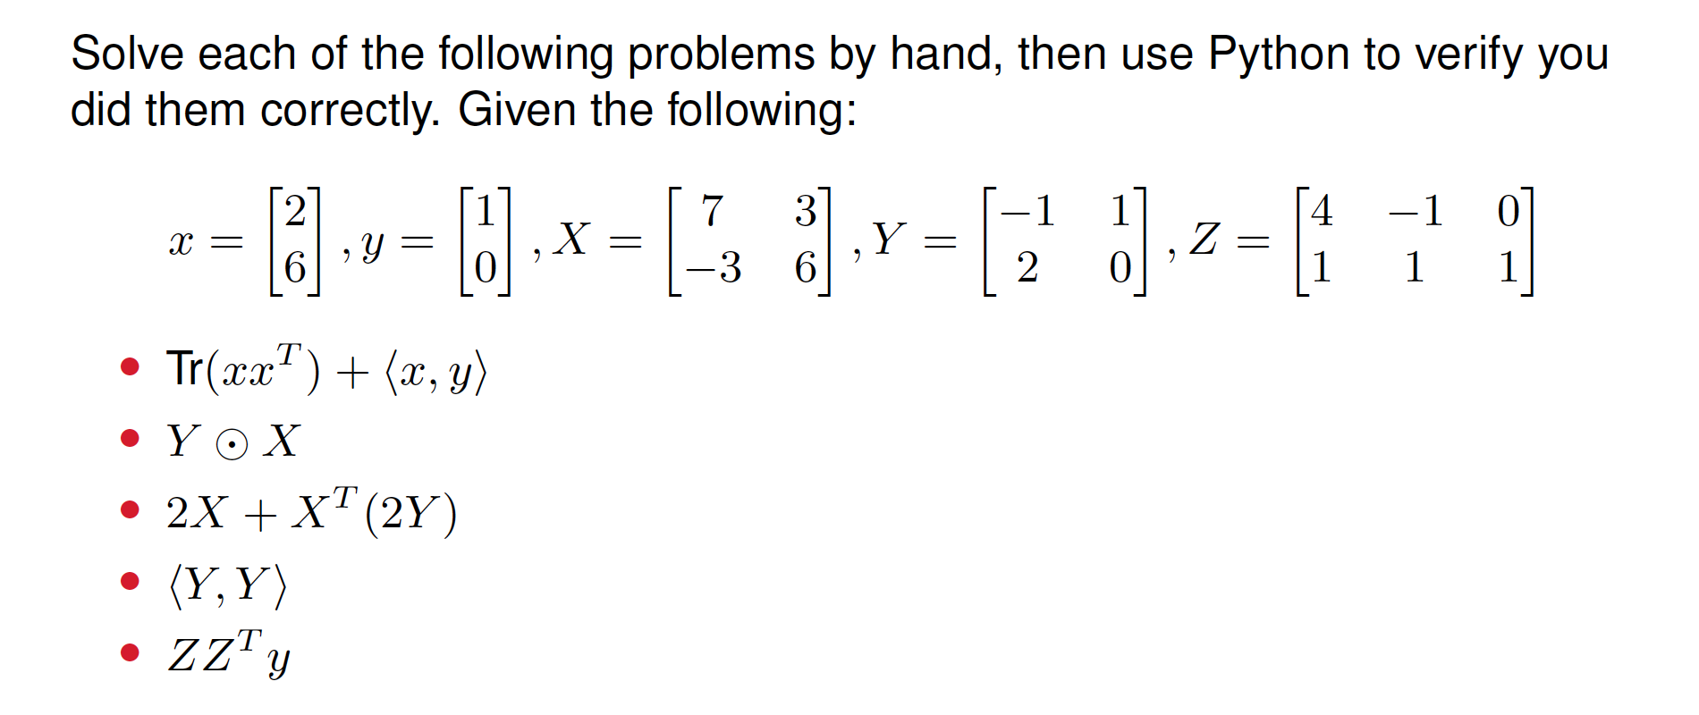
Summary practice exercises
Notes:
Solve this problem both by hand and in Python

Slide 35
Kahoot matrix operations

Slide 36
Python code in CANVAS

Slide 37

























Solutions

Slide 38

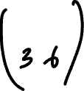


















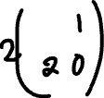






Slide 39




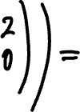








Slide 40



